Slide 1
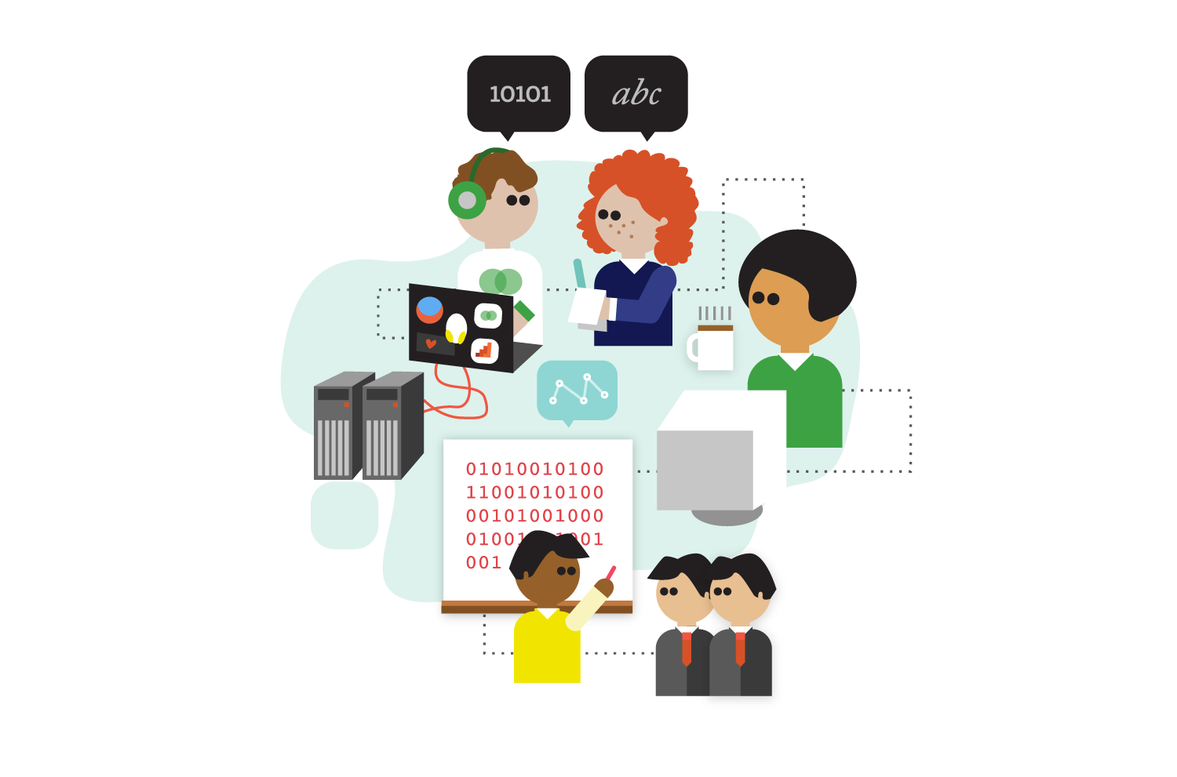
Introduction to Business Intelligence Universitas Surabaya

Slide 2

Definition
Of Business Intelligence
Features of BI: Task of BI, Foundation of BI, Realization of BI, Delivery of BI

Slide 3

1.
Task of BI
Providing decision support for specific goals defined

Slide 4
Challenges
Well structured understanding of the business logic in almost all domain areas
New organizational structures, i.e decentralized

Slide 5

2.
Foundation of BI
Empirical information, knowledge, and theories

Slide 6
Challenges
Not well-structured data
Visual mining, text mining, opinion mining, social network analysis

Slide 7

3.
Realization of BI
This is a system using the actual capabilites in ICT

Slide 8
Challenges
Software as a Service
Large and complex data sets
Cloud computing and distributed computing

Slide 9

4.
Delivery of BI
Right time, right people, appropriate form

Slide 10
Challenges
Mobile devices
Quality of real time information

Slide 11

PUTTING BUSINESS INTELLIGENCE INTO CONTEXT

Slide 12

BI Scenarios
BI separated from strategic management
BI support monitoring of strategy performance
BI feedback on strategy formulation
BI as a strategic resource

Slide 13

BI separates from strategic management
Concerned of short term target
Ex: a department of an enterprise, clinic in a hospital
Standardized reports

Slide 14

BI support monitoring of strategy performance
Overall strategic goals
Data warehouse

Slide 15

BI feedback on strategy formulation
Evaluation of the performance using analytical methods
Optimization of a strategy
Balanced scorecard

Slide 16

BI as strategic resource
Input for the definition of the strategy
Ex: customer based marketing, development of SOP for patient treatment.

Slide 17

Perspectives
Production perspective
Customer perspective
Organizational perspective

Slide 18
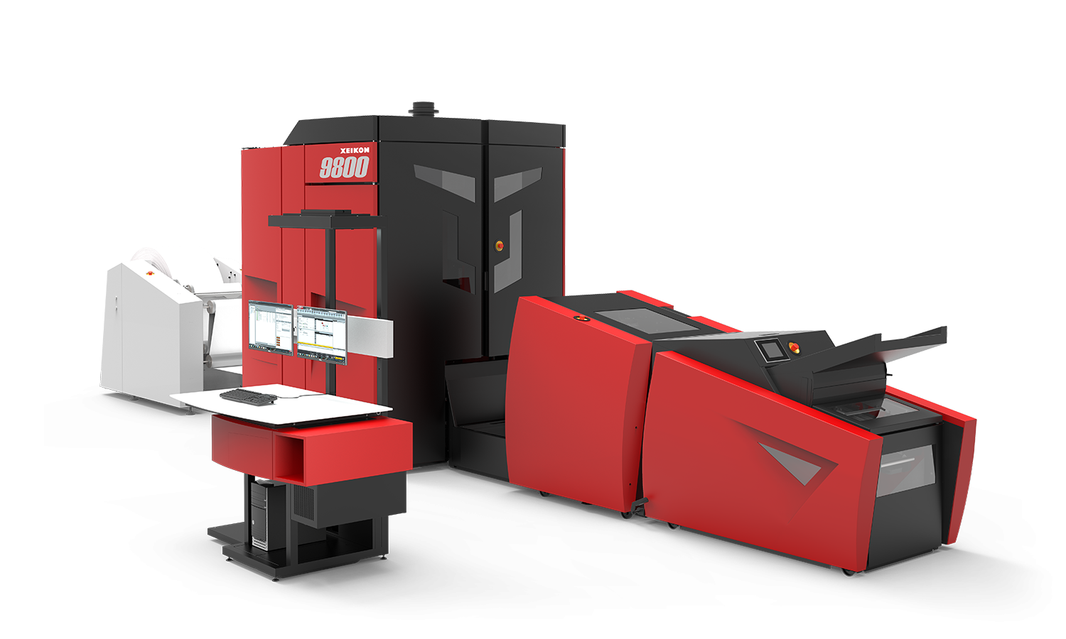
Production Perspective
What kind of products should be offered to customers
How the production should be operated

Slide 19

Customer Perspective
Customer behaviour
How customers perceive products or services
How they react to this offer

Slide 20

Organizational Perspective
Organizational background of the business process
Organizational background – production perspective
Influence of social networks on customer behaviour

Slide 21

Roles in Context of BI
Process owner
Process subjects
Process actors

Slide 22

Process Owner
Setting the rules governing the process
Enterprise or customers
Ex: patient....what?

Slide 23

Process Subject
Entities that identify the process instances
Customers, specific products, networks of people
Ex: a patient with a certain health problem shows up at the hospital triggering a certain treatment process

Slide 24

Process Actors
Part of the organization responsible for the production of goods or services

Slide 25

BI Views on Business Processes
Event view
State view
Cross-sectional view

Slide 26

Event view
Characterized by time stamp for the start, end, or resumption.

Slide 27

State view
Values of attributes
State variables

Slide 28

Cross-sectional view
Events and state

Slide 29

KPIs as Goals for BI
Key Performance Indicator
Influential factors

Slide 30

KPI
Link activities and objectives
Measurable quantity

Slide 31

Influential factors
Attribute that may influence the behaviour of the KPI

Slide 32

Typology of Analytical Goals
Descriptive goals
Predictive goals
Understanding goals

Slide 33

Descriptive goals
Reporting: information for decisions
Segmentation: group the instances
Detect interesting behaviour: process identification

Slide 34
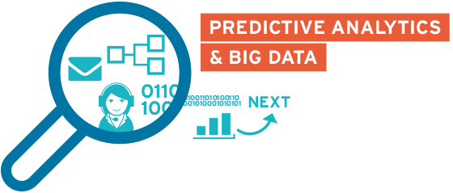
Predictive goals
Regression: function that allows the prediction of the output from a number of input variables (influential factors)
Classification: given a partition for observed instances into disjoin classes, assign a new instance to one of the classes

Slide 35

Understanding goals
Process identification: Identify the rules
Process analysis: investigate the performance of the instances

Slide 36

THANKS!
Any questions?
Next week:
Tasks and analysis formats
Use cases

